Slide 1
DAT540 Final project
Group 16
Project 8: Solar radiation
Mohammed Ali, Omar Kotb, Ahmed Abdelhameed, Sindre Leidland, Daniel Fylling

Slide 2
AGENDA
Introduction
Preprocessing and analysis
Feature engineering
Machine learning models
Data splitting
Model selection
Performance
ML-model comparison
Impact of feature engineering – “Sun index”

Slide 3

introduction
The dataset
These datasets are meteorological data from the HI-SEAS weather station from four months, September through December 2016.
Dataset includes solar radiation readings, time recording and other weather-related readings such as temperature and humidity.
Relevance
The sun is a massive source of energy, and green energy is increasingly important to ensure sustainability for human civilization on earth. Predicting solar radiation will be important for decision making in politics and energy sector.
Approach
After analyzing the dataset, we arrived at the following main pursuits:
We want to study the effectiveness of machine learning algorithms in predicting solar radiation based on other variables given in our dataset.
Some special attention will be paid to feature engineering since we know that the movement of the sun is very predictable.
Image from https://www.hi-seas.org/

Slide 4
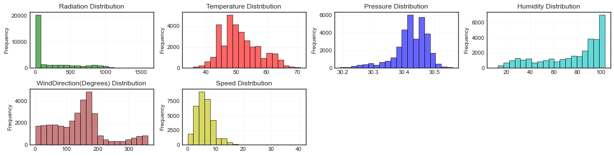
Preprocessing and analysis
Data cleaning and preprocessing.
No missing data within each row, or entry.
Inconsistent data sampling rate identified.
Split all time variables into subclasses e.g. Time of day into ‘Hours’, ‘Minutes’, and ‘Seconds’, so that they can be used as integers rather than strings.
Non-changing variables dropped.
Outliers were defined as outside of 3 standard deviations for each variable. Insignificant number of entries were dropped from this process.
Data visualization and analysis.
Correlation map shows strong relationship between radiation and temperature.
Selection of significant features.
Noticed that solar radiation has most values close to zero and the rest quite uniformly distributed. Based on this we generated variable “Sun Index” that also correlates well to target variable.

Slide 5
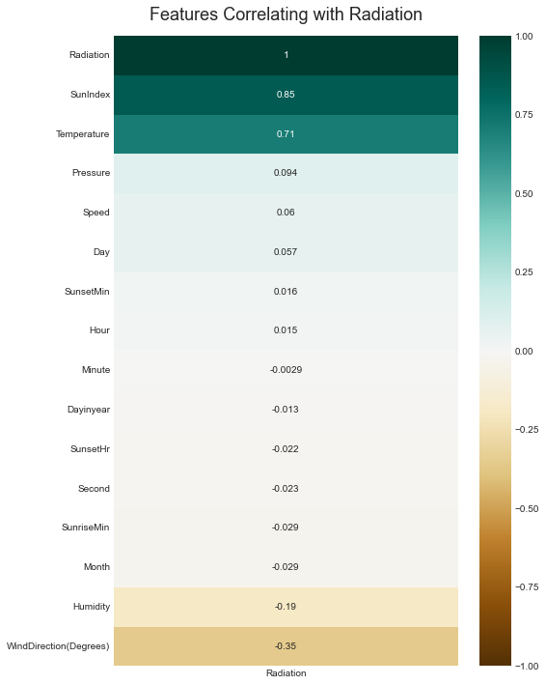
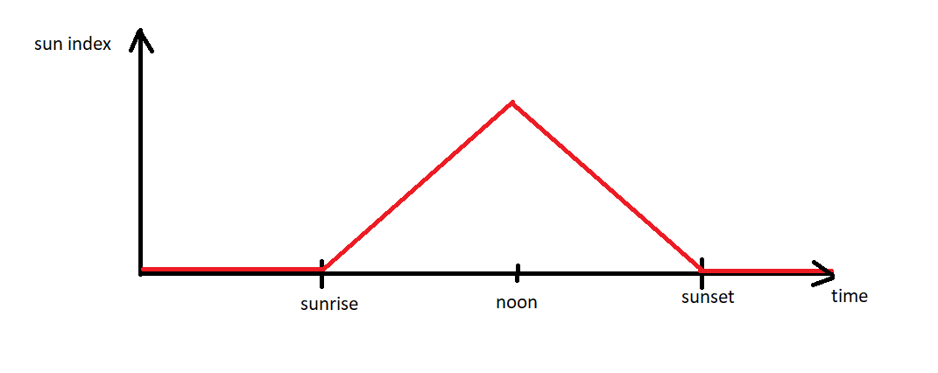
Feature engineering
Sun index
Introduced from other time variables in the dataset. It was set to zero outside of sunshine hours, gradually increase from sunrise to mid-day (midpoint between sunrise and sunset), then decrease back to zero at sunset.
Input: Time of day, Sunrise time, Sunset time
Output: Sun Index ->
The variable will carry properties reflecting both daily and seasonal cycles.
Summer Winter

Slide 6
Data splitting - training-, and test set
5 days chosen arbitrarily for testing.
Dataset was split accordingly into a training set and test set.
Training data was scaled using Minmaxscaler to transform all the values in range between 0 to 1. This is done to help ML models weight the different variables correctly, hence improving the learning process.
The engineered variable “Sun Index” was omitted from training set to evaluate the ML-algorithms in a “sterile” environment, free from human judgement.

Slide 7
Machine learning models

Slide 8
Model selection
Prediction model selection for analysis:
Baseline
– prediction is equal to previous day to target day.
Linear regression
– attaches linear coefficients to each variable and optimizes for best fit.
KNN
– Prediction produced by interpolation of the targets of the nearest neighbors in the training set variables (N=2).
Random forest
– Prediction is made by an aggregate of decision trees, that are train based on if a certain variable will add information about the target variable or not
eXtreme Gradient Boosting
– combines estimates from several simpler models to achieve higher accuracy.
All ML methods were applied using scikit-learn library, with the exception of the baseline model – that was performed manually.

Slide 9
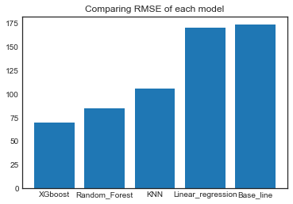
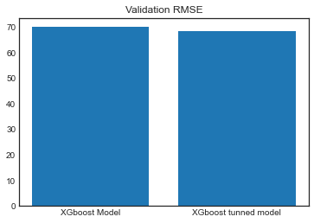
Performance Comparison
To compare performance of different prediction algorithms RMSE (Root Mean Square Error) was calculated for each method.
XGBoost showed the best performance through achieving the lowest RMSE.
Through manual tuning of the best performing method, we were able to increase accuracy of predictions slightly.

Slide 10
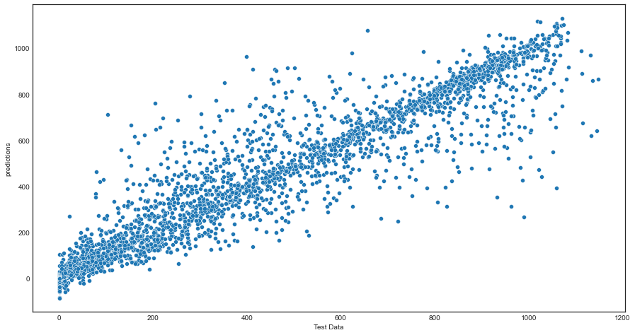
XGBoost predictions
Showing results for prediction vs actual radiation for every test data entry.
The red line represents “correct” predictions.
Due to the chaotic nature of weather, it is not expected for the algorithm to be able to predict every variation perfectly.

Slide 11
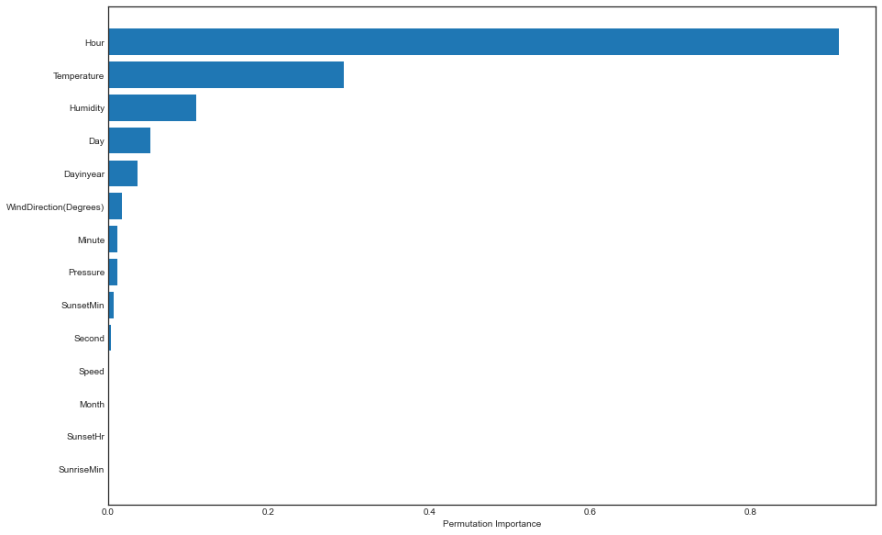
Permutation features importance
The features importance shows that Hours (hour of day), Temperature and humidity have the highest prediction power.
This makes sense when reminding ourselves of the cyclic nature of the sun and heat that sunlight carries.
Humidity is also closely linked to temperature and hot air can hold more moisture than cool air.
The variable “day of year” was generated to let the algorithm have a reliable source for the progress toward winter, where each day through our dataset is expected to be a bit colder than the last.
It is a bit surprising that “day” has the fourth highest importance as we would not expect the 5th of September to have anything in common with the 5th of October.
What the days do have in common is that the 25th will in general have less radiation than the 5th .

Slide 12
impact of engineered variable -sun index

Slide 13
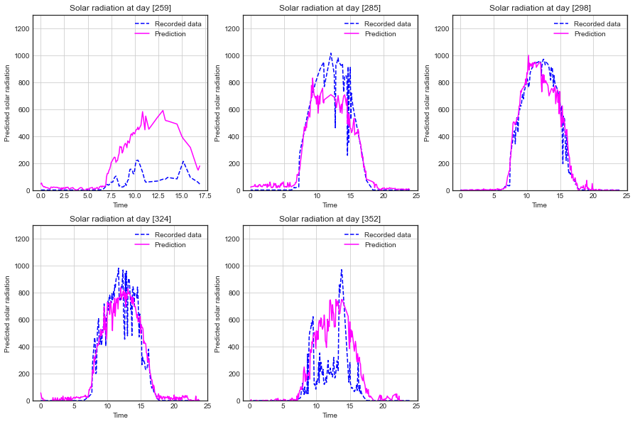
Predictions excluding “sun index”
Predictions are best while it is sunny.
No variables provide input for cloud coverage or visibility, so predictions for what look like cloudy days are less accurate.
Day [259] is either very cloudy, or something was off with the sensors. As we can see the sensors ran offline at approx. 17:00 that day.

Slide 14
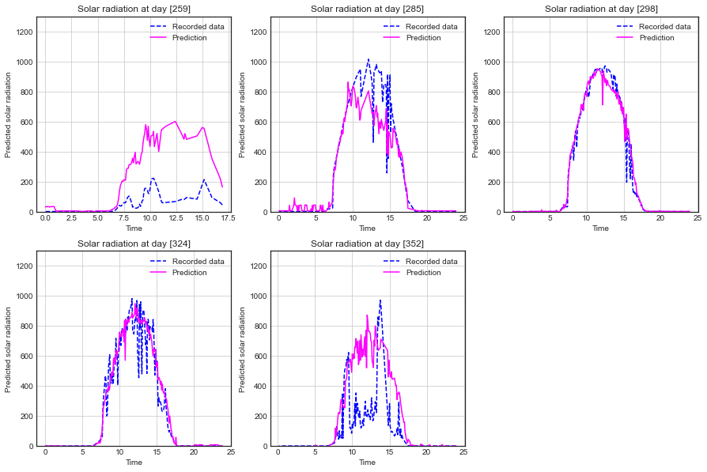
Predictions including “sun index”
By comparing to previous plot, we can see that predictions are better after applying the engineered variable.
Night-time predictions are more consistent, and predictions seem closer to actual data in general.

Slide 15
conclusion
Standard steps for building a machine learning model were followed:
Explorative data analysis and pre-processing (data cleaning).
Feature analysis and engineering.
ML-training of different algorithms.
We can see that all steps have a significant impact on the quality of the final model. We demonstrated that hyperparameter tuning can reduce prediction error, although the effect seen was small.
We have seen how different ML-models work and which are more suited for a dataset like what we had.
XGBoost performed best out of the ML-algorithms we tested and was further improved by hyperparameter tuning and feature engineering.

Slide 16
THANK YOU

